Slide 1


online
library
Mira farhat & Aya bitar Lebanese University 2023/2024

Slide 2

Syllabus
Introduction
Problems and Objectives
User Roles :Admin/user
CDM
Technologies and Languages

Slide 3
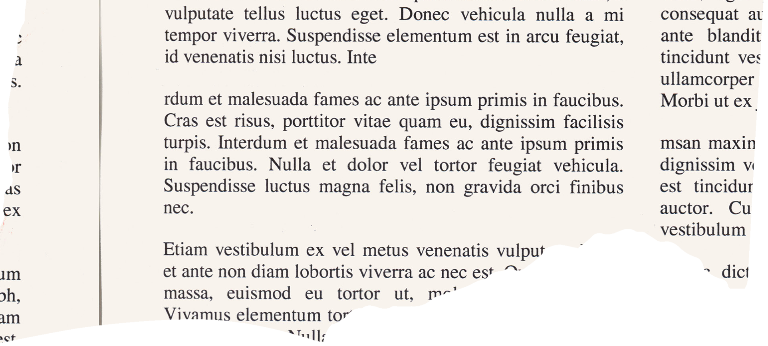




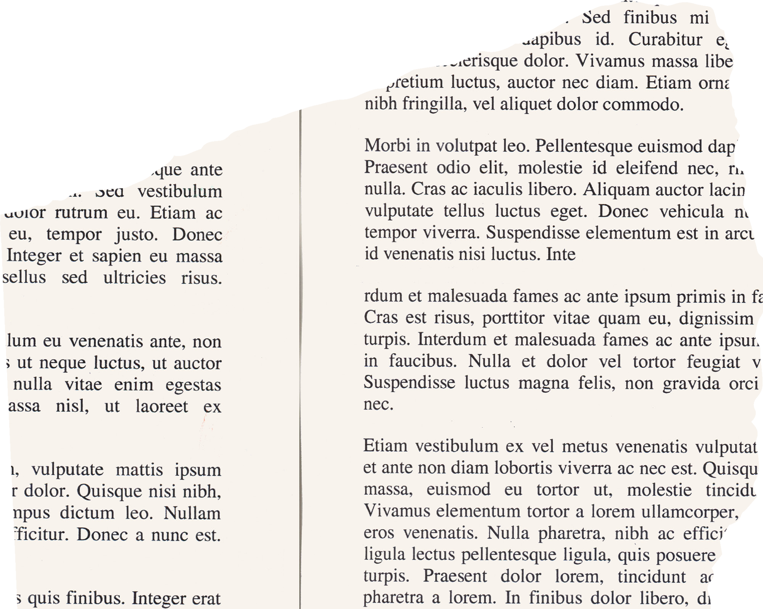
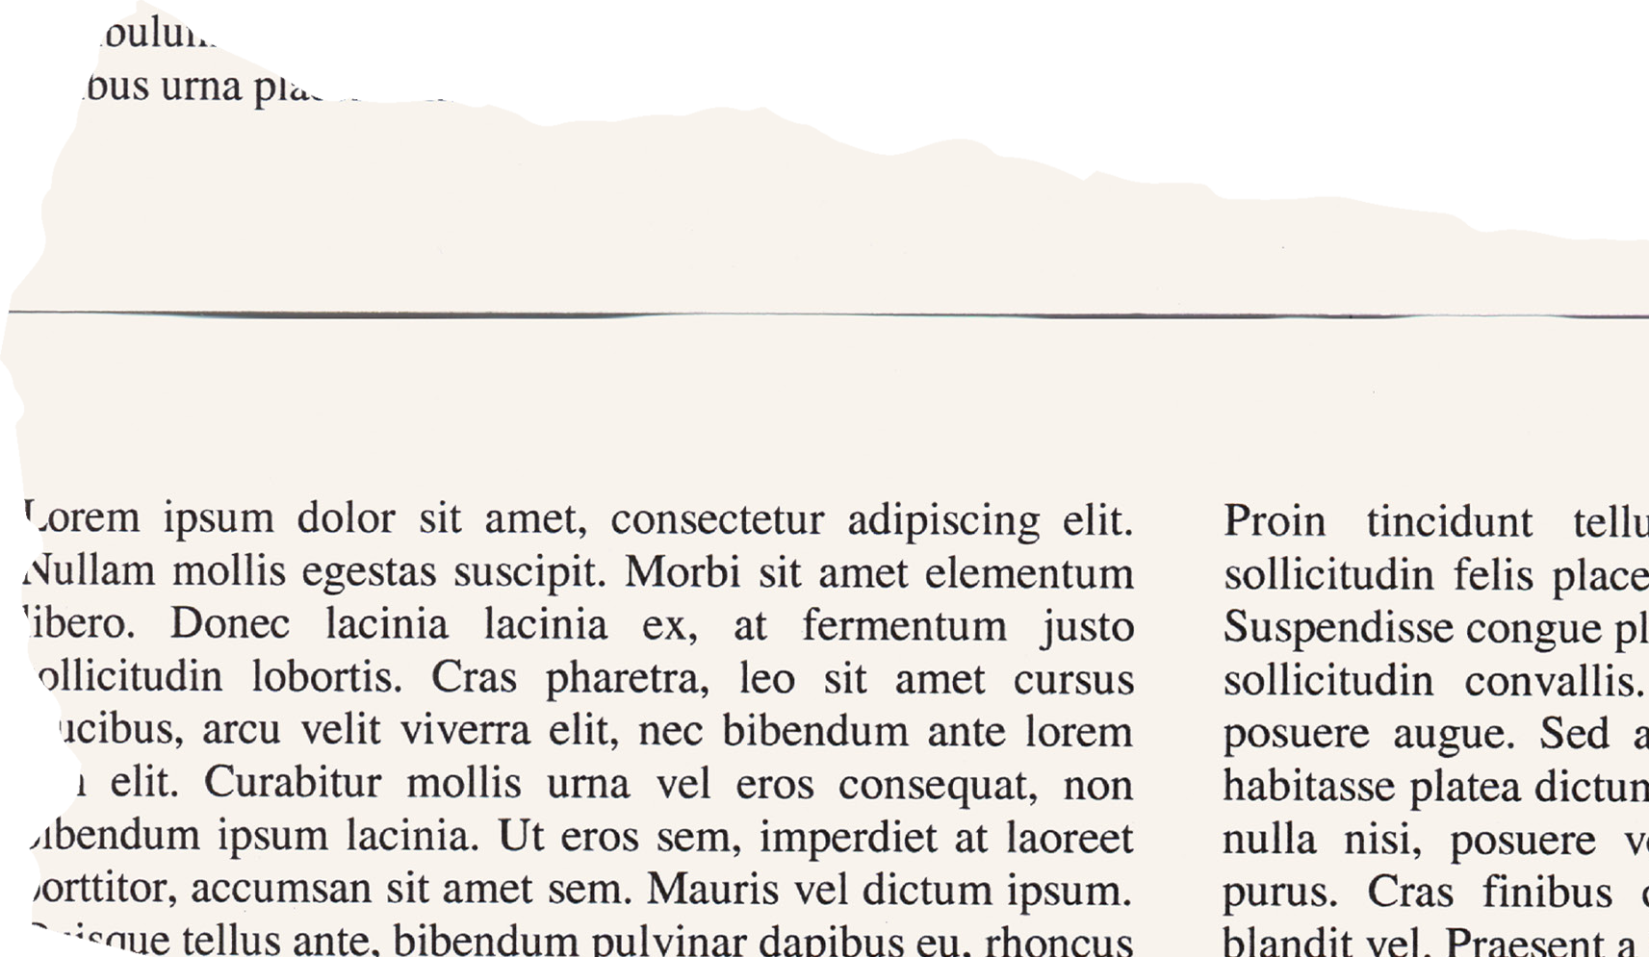
Introduction
"This project, named Raf, is a one-stop solution designed to offer a variety of services in a single platform. Its primary goal is to develop a comprehensive online library that provides seamless access to books while also integrating graphic design services. With a focus on enhancing user experience, the platform features a modern and responsive interface, enabling users to effortlessly browse, rent, purchase books, and request custom design services—all in one convenient place."

Slide 4
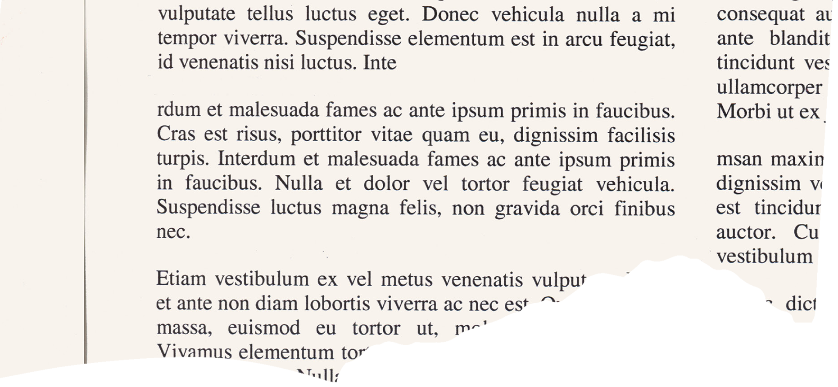





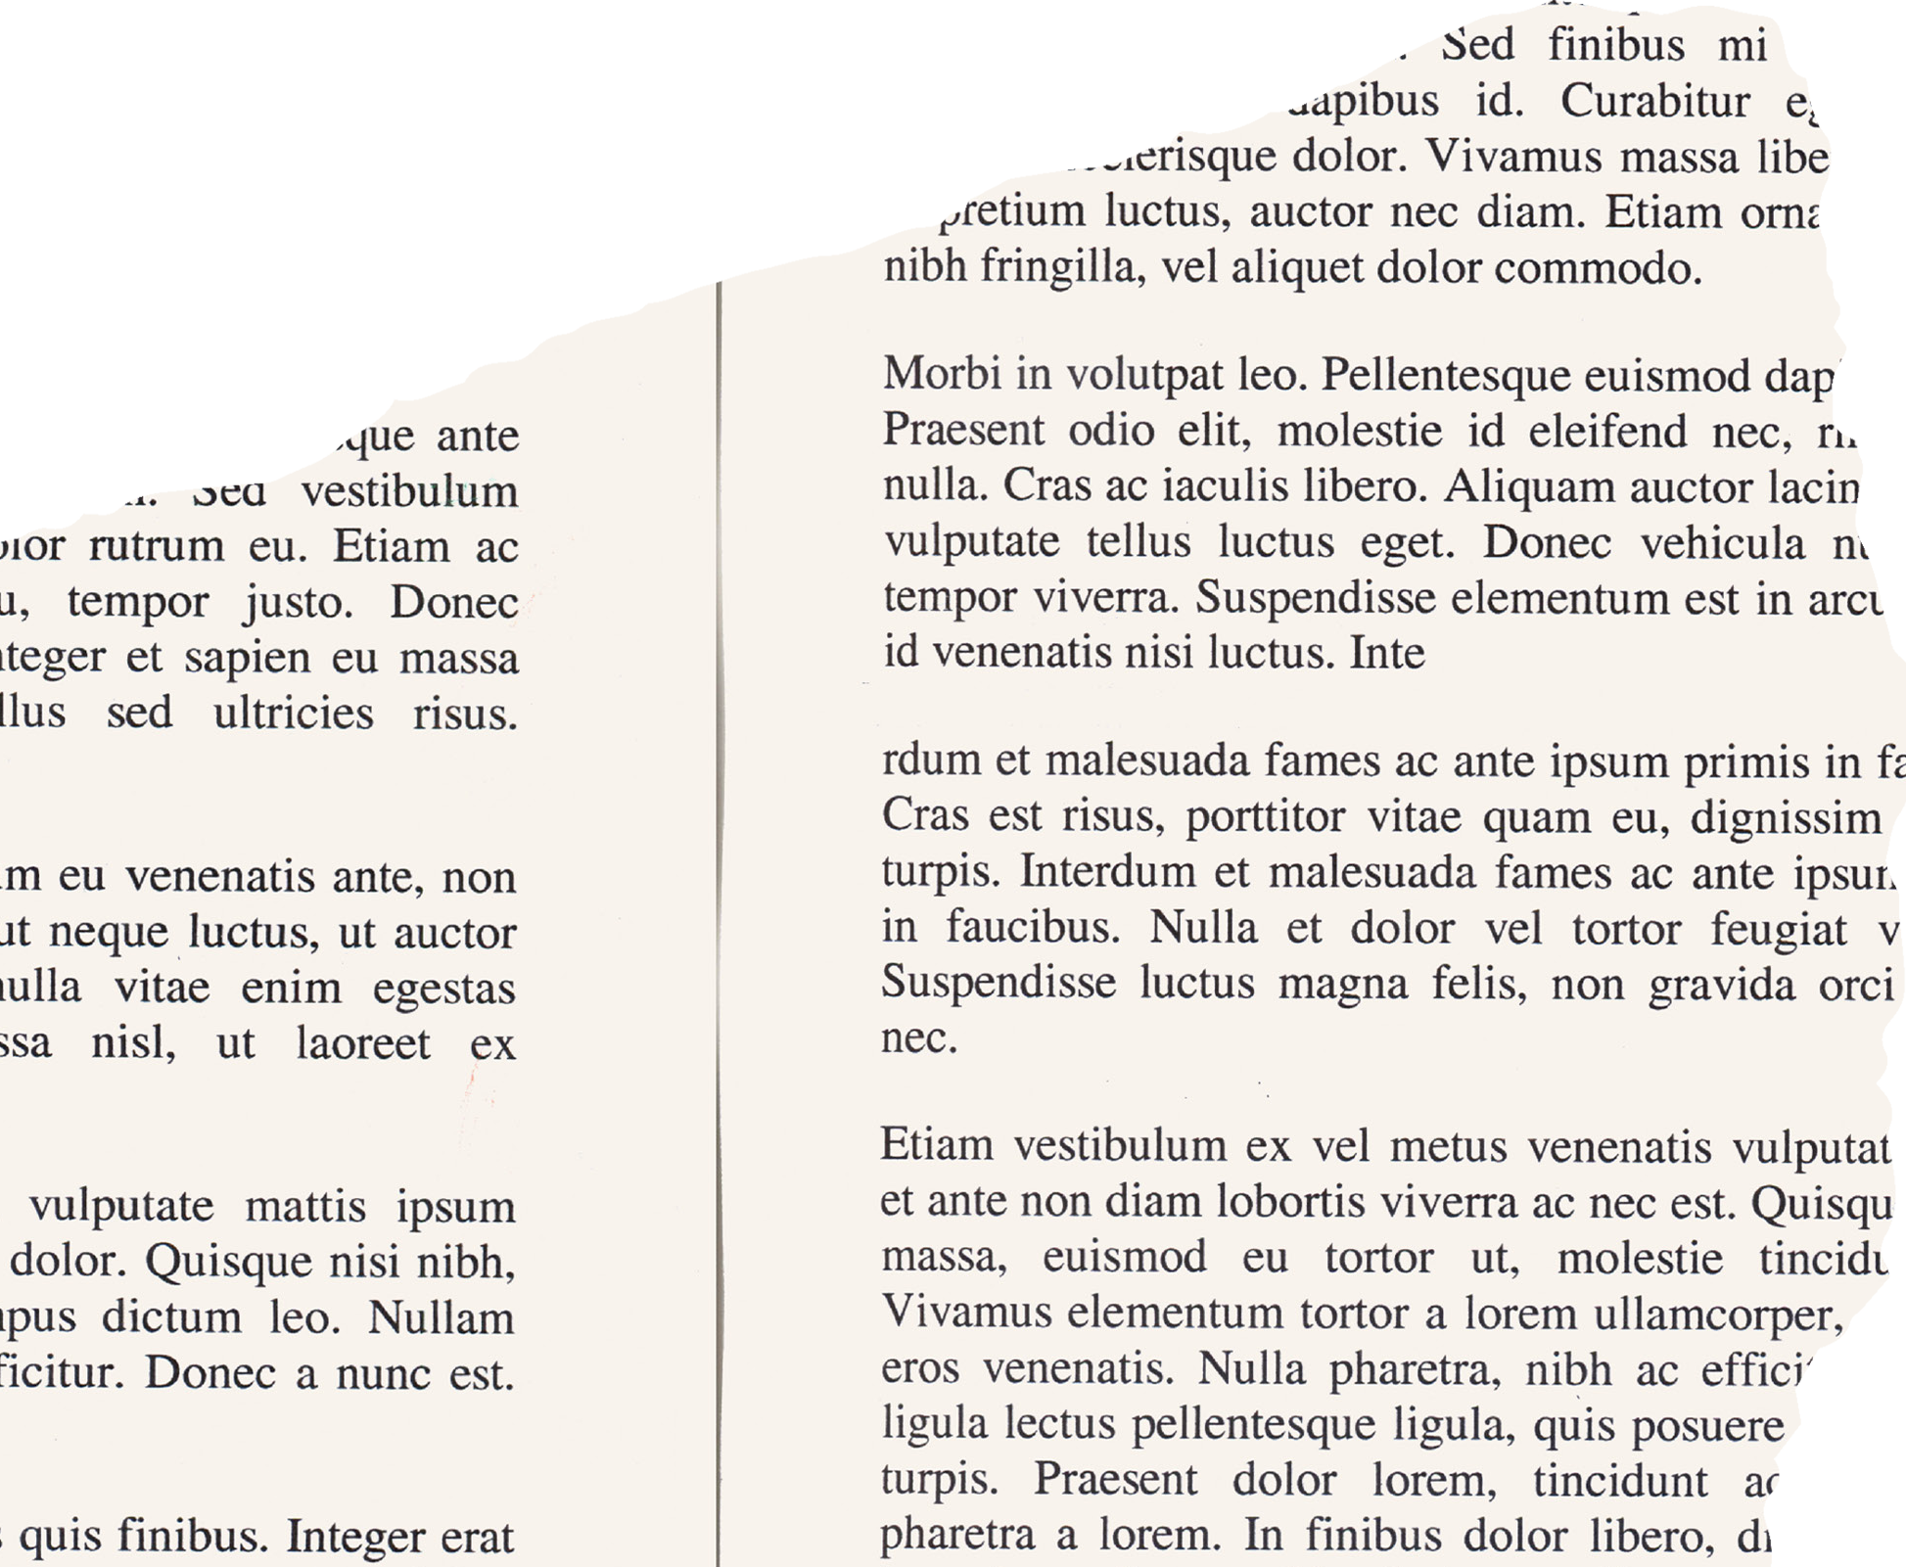







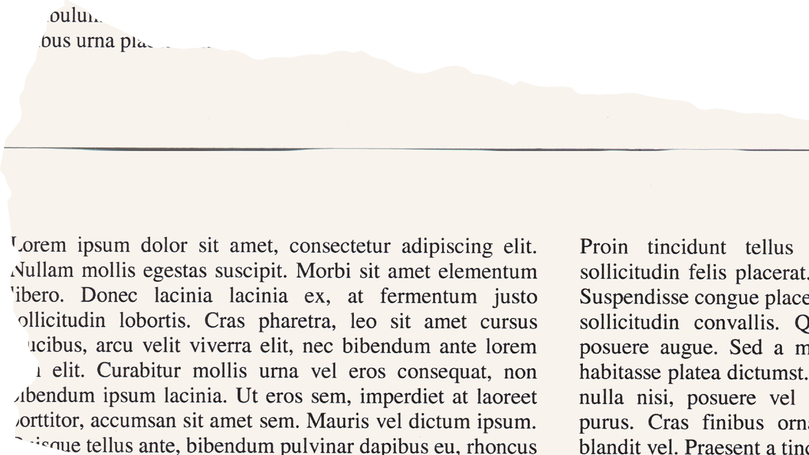





Problems and Objectives
Problem:
"Traditional libraries are limited by physical space, outdated cataloging, and lack of online integration, making it difficult for users to find, rent, and purchase books."
Objective:
"Create a seamless platform for browsing, renting, and purchasing books, with added services like custom graphic design for book covers and promotions, streamlining the entire process."

Slide 5


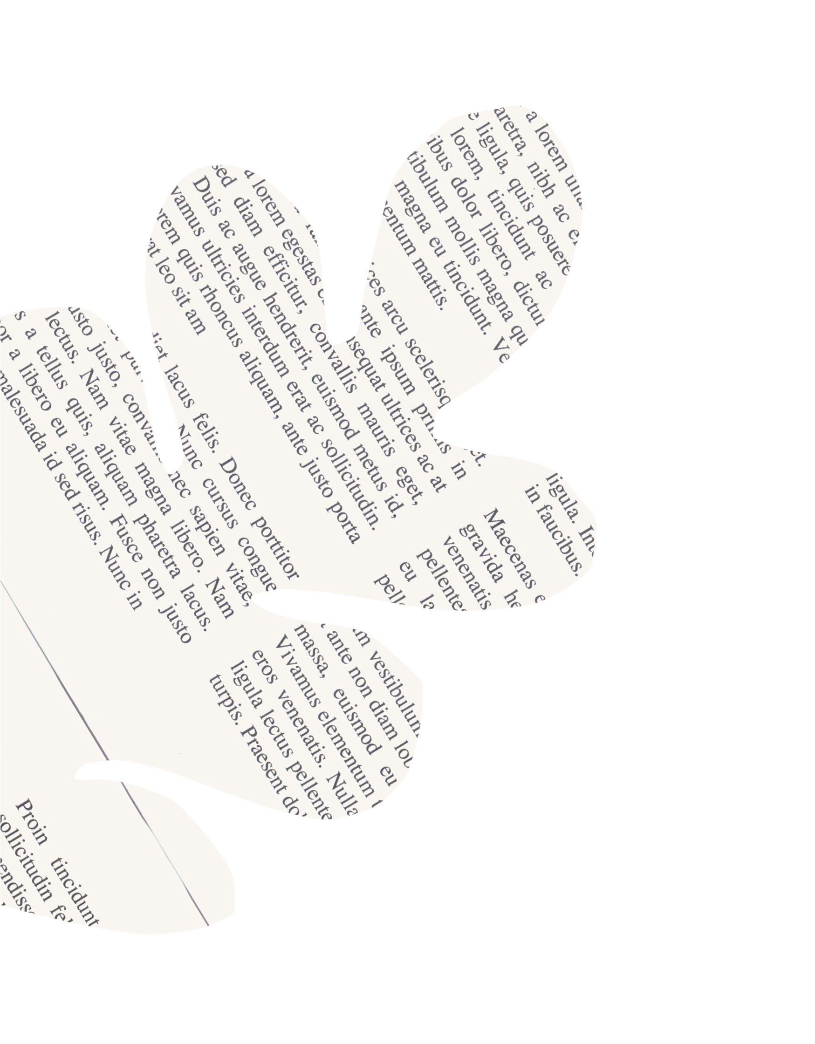
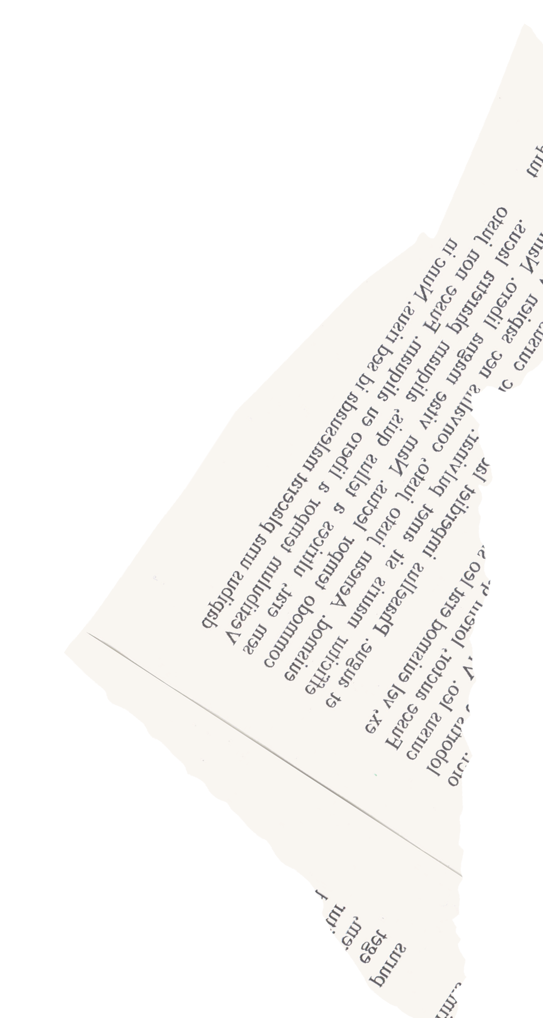







User Roles
Admin
Oversee messages sent by people
Maintain Inventory
Handle orders and Graphic design requests

Slide 6
User Roles
User
Search, Purchase or rent books
Request custom graphic designs
Submit book reviews

Slide 7
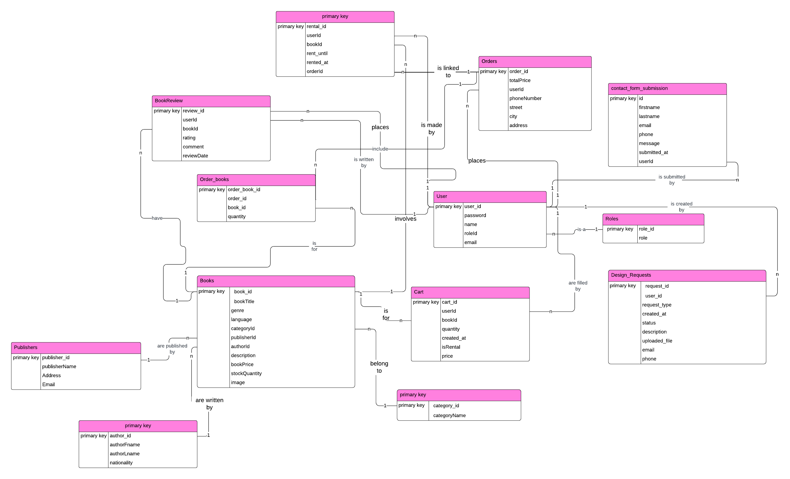
CDM

Slide 8








Technologies and Languages
Backend:PHP Database:Mysql

Slide 9
Thank you for your time and attention !
:)

